Slide 1
Data Structures and Algorithms (CCE 221)
By
Dr : Asmaa Aly Hagar

Slide 2
Course Academic Calendar
Week Num | Date | Content
Week1 | 25/9/2025 | Introduction to Data Structures + Mathematics Review + Review of Concepts of ‘C++’
Week2 | 02/10/2025 | Sparse Matrix, Concepts of Class, and Analysis of Algorithms
Week3 | 09/10/2025 | Linked Lists
Week4 | 16/10/2025 | Stack
Week5 | 23/10/2025 | Queue
Week6 | 16/10/2025 | Trees
Week7 | 30/10/2025 | Midterm
Week8 | 06/11/2025 | AVL Trees
Week9 | 13/11/2025 | Priority Queues and Heaps
Week10 | 20/11/2025 | Graph
Week11 | 27/11/2025 | Searching and Sorting
Week12 | 04/12/2025 | Hashing

Slide 3
Lecture2

Slide 4
Contents of the Lecture
Sparse Matrix
Concepts of Class
Analysis of Algorithms

Slide 5
Sparse Matrix

Slide 6
What is Sparse Matrix
In computer programming, a matrix can be defined with a two-dimensional array.
Any array with ‘m’ columns and ‘n’ rows represents a mXn matrix.
There may be a situation in which a matrix contains more number of ZERO values than NON-ZERO values.
Such matrix is known as sparse matrix.
Sparse matrix is a matrix which contains very few non-zero elements.
When a sparse matrix is represented with two-dimensional array, we waste lot of space to represent that matrix.
For example, consider a matrix of size 100 X 100 containing only 10 non-zero elements. In this matrix, only 10 spaces are filled with non-zero values and remaining spaces of matrix are filled with zero. That means, totally we allocate 100 X 100 X 2 = 20000 bytes of space to store this integer matrix, and to access these 10 non-zero elements we have to make scanning for 10,000 times.
Sparse matrix can be represented by using TWO representations, such as
Triplet Representation
Linked Representation

Slide 7
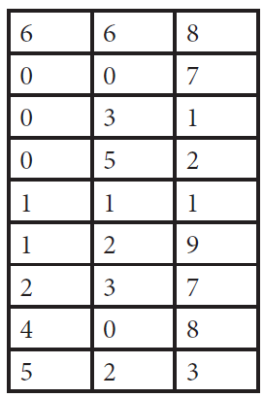
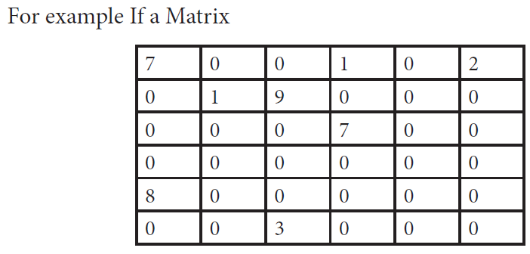
Method 1: Triplet Representation
In this representation, we consider only non-zero values along with their row and column index values.
In this representation, the 0th row stores total rows, total columns, and total non-zero values in the matrix.
The declaration of the sparse matrix takes the form
Data type sparse[terms + 1][3];
Where the term is the number of non zero elements in the matrix.
Sparse Matrix

Slide 8
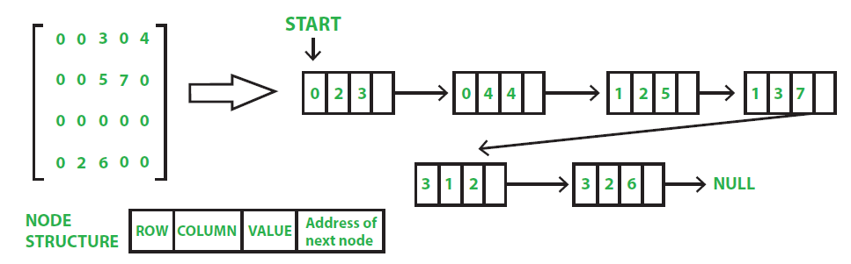
Method 2: Using Linked Lists
In linked list, each node has four fields. These four fields are defined as:
Row: Index of row, where non-zero element is located
Column: Index of column, where non-zero element is located
Value: Value of the non zero element located at index ( row, column)
Next node: Address of the next node

Slide 9
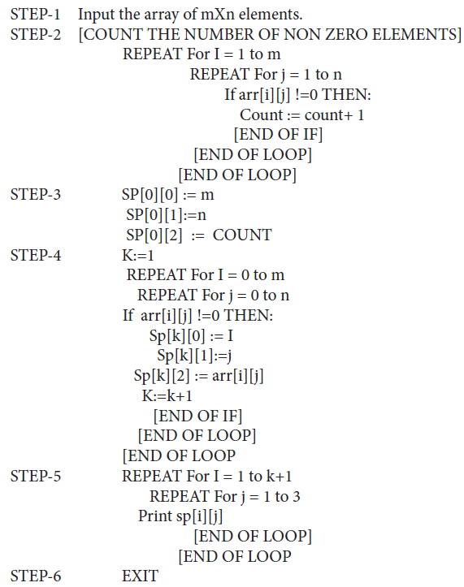
Algorithm to Represent the Sparse Matrix

Slide 10
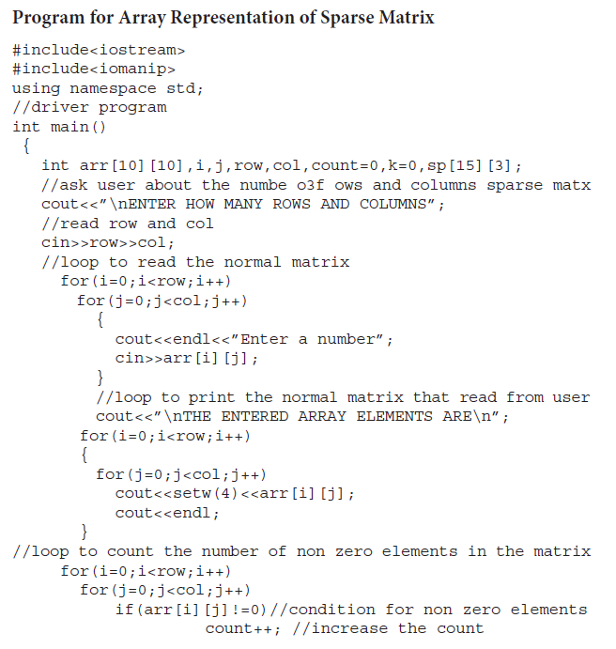
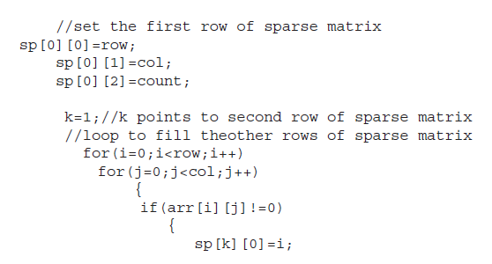
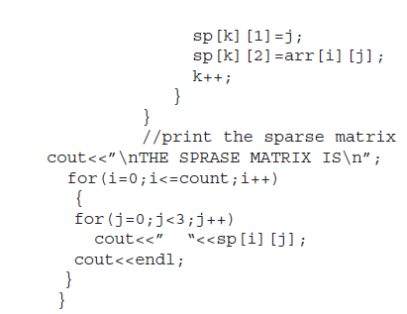
Programs Related to Sparse Matrix

Slide 11
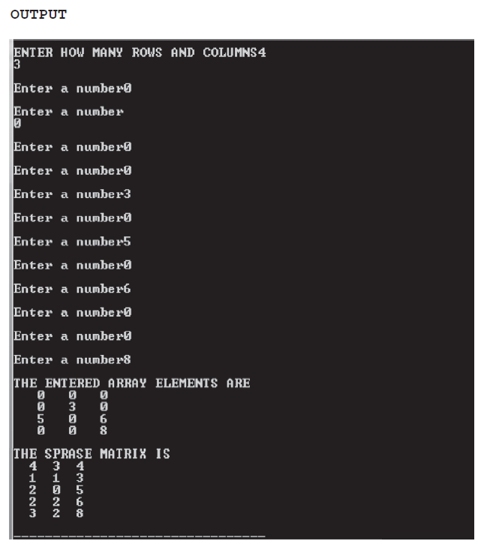
Programs Related to Sparse Matrix

Slide 12
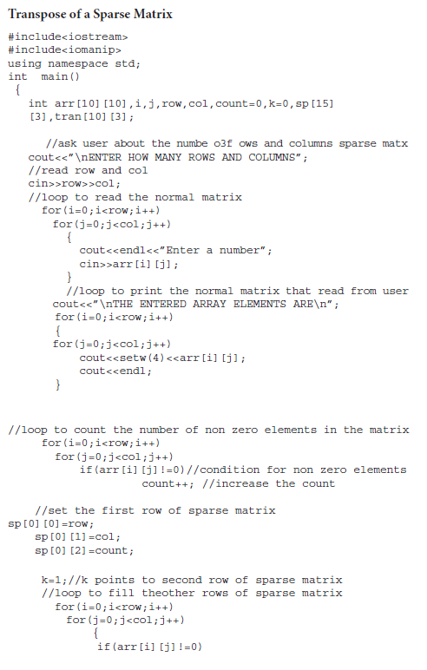
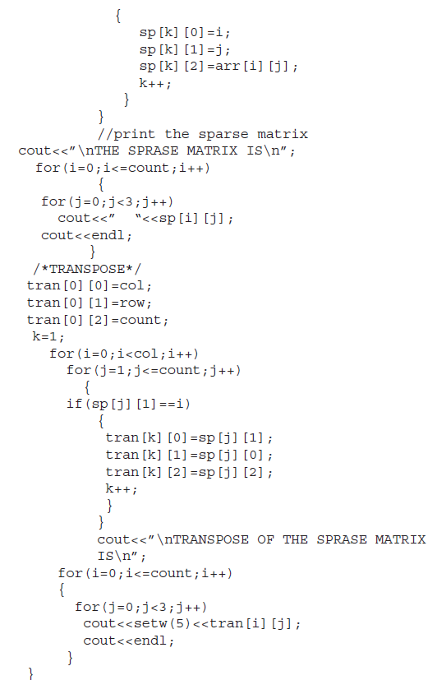

Slide 13
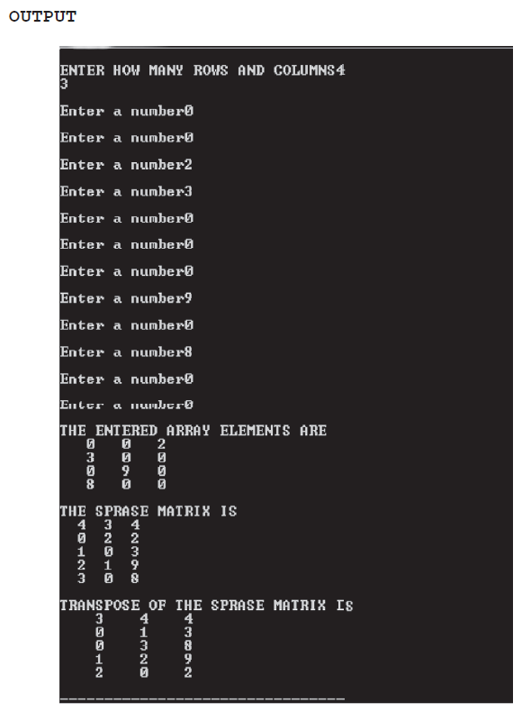

Slide 14
Why to Use Sparse Matrix Instead of Simple Matrix?
Storage:
There are lesser non-zero elements than zeros and thus, lesser memory can be used to store only those non-zero elements.
Computing time:
Computing time can be saved by logically designing a data structure traversing only non-zero elements.
Sparse matrices can handle much larger datasets.

Slide 15
Drawbacks of Sparse Matrix
Not all problems can be represented as sparse matrices.
Sparse matrices may lose information since many elements are zero.
Choosing the right algorithms and libraries for sparse matrix operations can be challenging.

Slide 16
Sparse Matrix and Machine Learning
In Data Storage
For example:
Movie Application like Netflix
Suppose there are 100,000 movies in the catalog.
A single user may have watched only 200 movies.
So, the "watched/not watched" array for this user is mostly 0s (not watched), with only a few 1s (watched).
That means 99.8% of the entries are zeros → a sparse matrix.
E-commerce Application
Imagine an online store has 50,000 products.
A customer may have purchased 20 items only.
Representing purchases with 1 (bought) and 0 (not bought) leads to a massive array with almost all zeros.
Again, a sparse matrix.
Music App (Spotify, Apple Music)
If the app contains 10 million songs, a user may have listened to only 5,000 songs.
The rest remain unlistened (zeros).
This creates a highly sparse representation.

Slide 17
Sparse Matrix and Machine Learning
In Data Preparation
When we prepare data for machine learning, we often need to convert categorical or text data into numerical vectors.
These encodings typically result in huge arrays, but most of the entries are zero, which naturally creates a sparse matrix.
Examples:
One-Hot Encoding
Used for categorical data (e.g., “red”, “blue”, “green”).
Suppose we have 10,000 unique categories (like product IDs or words).
Representing one item requires a vector of length 10,000 with only 1 position as ‘1’, and all others are 0.
Example:
Categories = ["cat", "dog", "bird"] => "dog" → [0, 1, 0]
Most entries are 0 → sparse representation.
Count Encoding (Bag of Words model)
It is used in the representation of the frequency of words in a document.
Example:
Vocabulary = ["apple", "banana", "cat", "dog", "elephant"] , Document = "dog cat cat“
Vector = [0, 0, 2, 1, 0] => Most entries are 0 → sparse representation.

Slide 18
Sparse Matrix and Machine Learning
TF-IDF Encoding (Term Frequency – Inverse Document Frequency)
Builds on count encoding but adjusts weights by how rare/common words are.
Vocabulary might still be tens of thousands of words.
Each document activates only a tiny fraction of those words → most positions are 0.
Example:
Vocabulary = ["data", "science", "machine", "learning"] Document = "machine learning“
=> TF-IDF = [0, 0, 0.7, 0.9]
Again, very sparse across a large vocabulary.

Slide 19
Sparse Matrix and Machine Learning
Machine Learning Study Areas
In many ML tasks, the input data is high-dimensional but mostly empty (zeros) → a sparse matrix.
Handling sparse matrices efficiently is important, because storing them as dense arrays (inverse of Sparse Matrix) wastes memory and slows down computations.
Examples:
Natural Language Processing (NLP – Text Documents)
Text documents are often represented as vectors using Bag of Words, TF-IDF, or word embeddings.
If the vocabulary has 100,000 words, each document only contains a few hundred → meaning most entries are zero.
Example:
Document = "machine learning is fun“
Vocabulary = 100,000 words
Vector size = 100,000 → only ~4 non-zero entries
Recommendation Systems (Product Catalogs)
Users interact with only a tiny fraction of available products/movies/songs.
Example:
Netflix:1 million users × 100,000 movies → matrix size = 100 billion cells.
But each user has only watched ~100 movies → 99.999% zeros.

Slide 20
Sparse Matrix and Machine Learning
Computer Vision (Images with Many Dark Pixels)
Images are stored as pixel grids (matrices).
Some applications (e.g., scanned text, medical images, astronomy images) have large areas of black (0) pixels.
Example:
A 1024×1024 grayscale image → 1,048,576 pixels, but maybe 70% are just black.

Slide 21
Concepts of Class

Slide 22
Object Oriented Programming (OOP)
OOP is a programming paradigm (style of programming) that organizes software design around objects.
An object represents a real-world entity (like a car, student, bank account).
Each object has:
Attributes (data/properties) → variables
Behaviors (functions/methods) → operations it can perform
In C++, OOP is implemented mainly using classes and objects.
A class in C++ is a user-defined data type that combines data and functions into a single unit, providing the foundation for OOP concepts like abstraction, encapsulation, inheritance, and polymorphism.

Slide 23
Main Principles of OOP
Encapsulation
Bundling of data and functions into a single unit (the class).
Protects data from direct access by using access specifiers (private, public, protected).
Example: A bank account class hides balance and only allows deposit/withdraw through functions.
Abstraction
Hiding implementation details and showing only the necessary features.
Example: When you use a car, you only know how to start/drive—it hides how the engine works internally.
In C++, abstraction is achieved using classes, abstract classes, and interfaces.
Inheritance
Allows a new class (child/derived) to reuse and extend features of an existing class (parent/base).
Promotes code reusability.
Example: A Car class can inherit from a Vehicle class.
Polymorphism
One name, many forms → the ability of functions or operators to behave differently based on context.

Slide 24
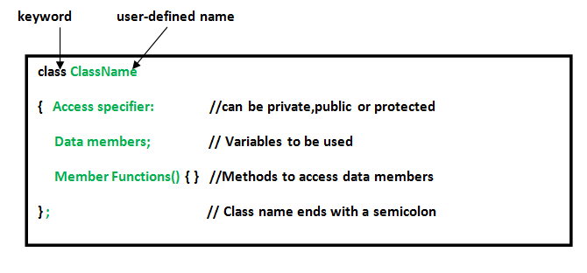
Classes
A class in C++ consists of its members:
Data: Member variables.
Member functions
Declaration:

Slide 25
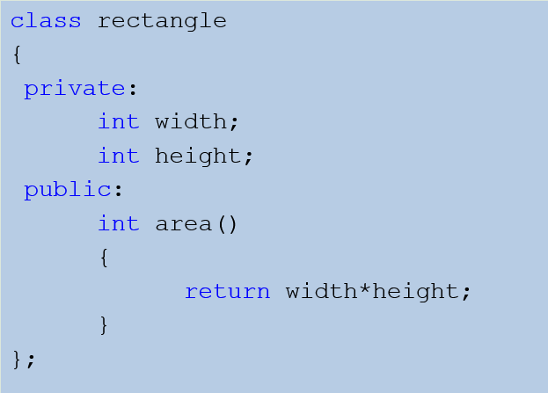
Example

Slide 26
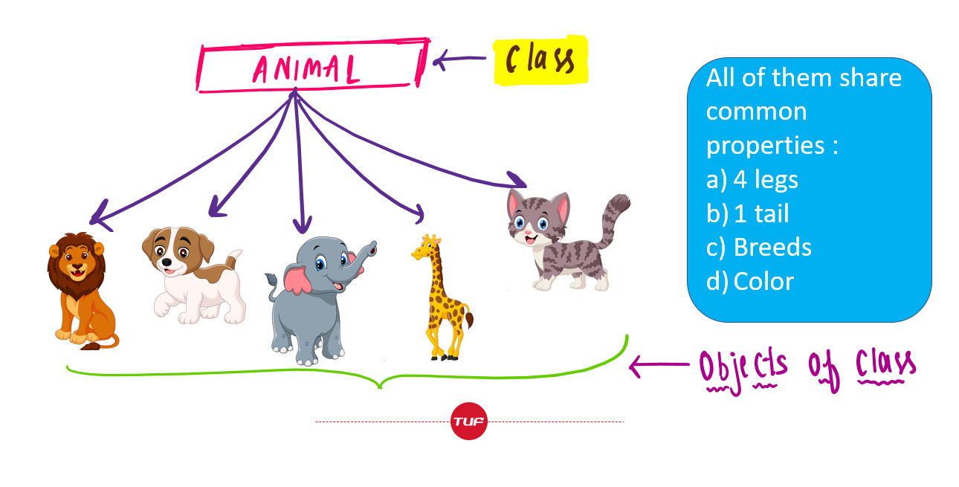
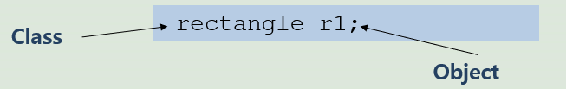
Class vs Object
A class defines a data type, much like a struct.
An object is an instance of the class.
They share the common structure that the class defines.
A classes is like a mold and objects are the items produced using the mold.

Slide 27
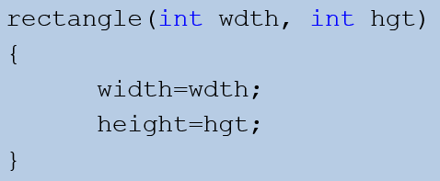
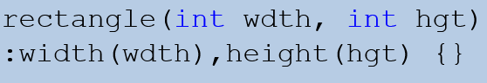
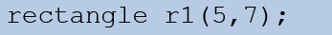
Constructors
A constructor is a method that describes how an instance of the class is constructed.
It is a function used to initialize the data of an object of a class.
Same name as class itself.
Cannot return anything, not even void
Called automatically with the creation of the object.
If no constructor is explicitly defined, one that initializes the data members using language defaults is automatically generated.
Definition:
OR
Creating an Object:

Slide 28
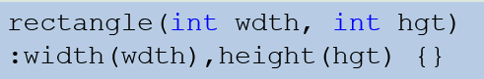
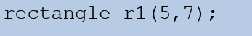
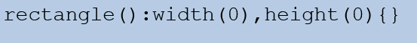
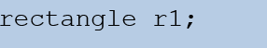
Constructors
You can have more than one constructor:
Constructor1:
Constructor2:

Slide 29
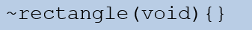
Destructors
A destructor is a special member function of a class that is executed when:
an object of it's class goes out of scope.
delete expression is applied to a pointer to the object of that class.
Program ends.
Is explicitly called
It can neither return a value nor can it take any parameters.

Slide 30
Scope Resolution
Each member function must identify the class that it is part of.
The syntax is ClassName::member.
The :: is called the scope resolution operator.
The signature of an implemented member function must match exactly the signature listed in the class interface.

Slide 31
Analysis of Algorithms

Slide 32
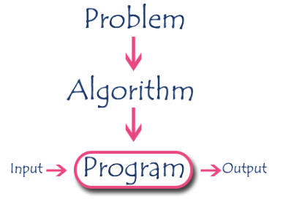
What is an algorithm?
An algorithm is a step-by-step procedure to solve a problem.
In normal language, the algorithm is defined as a sequence of statements which are used to perform a task.
In computer science, an algorithm can be defined as follows:
An algorithm is a sequence of unambiguous instructions used for solving a problem, which can be implemented (as a program) on a computer.

Slide 33
Specifications of Algorithms
Every algorithm must satisfy the following specifications...
Input : Every algorithm must take zero or more number of input values from external.
Output : Every algorithm must produce an output as result.
Definiteness : Every statement/instruction in an algorithm must be clear and unambiguous (only one interpretation).
Finiteness : For all different cases, the algorithm must produce result within a finite number of steps.
Effectiveness : Every instruction must be basic enough to be carried out and it also must be feasible.

Slide 34
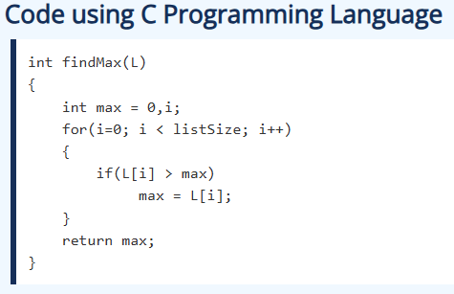
Example for an Algorithm
Problem Statement : Find the largest number in the given list of numbers?
Input : A list of positive integer numbers.
Output : The largest number in the given list of positive integer numbers.
Consider the given list of numbers as 'L' (input), and the largest number as 'max' (Output).
Algorithm
Step 1: Define a variable 'max' and initialize with '0'.
Step 2: Compare first number (say 'x') in the list 'L' with 'max', if 'x' is larger than 'max', set 'max' to 'x'.
Step 3: Repeat step 2 for all numbers in the list 'L'.
Step 4: Display the value of 'max' as a result.

Slide 35
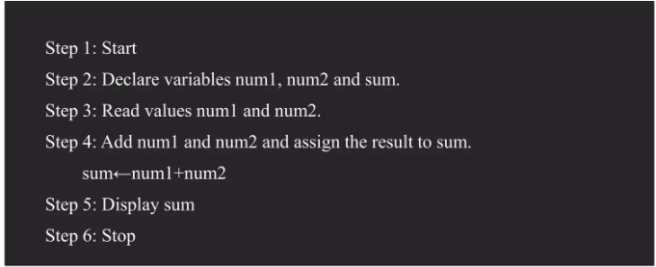
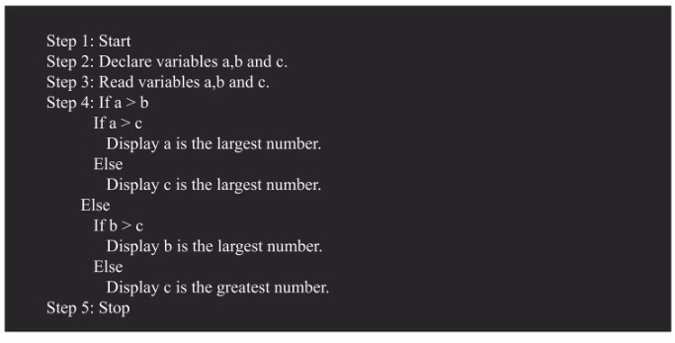
Examples
Add two numbers entered by the user
Find the largest number among three numbers

Slide 36
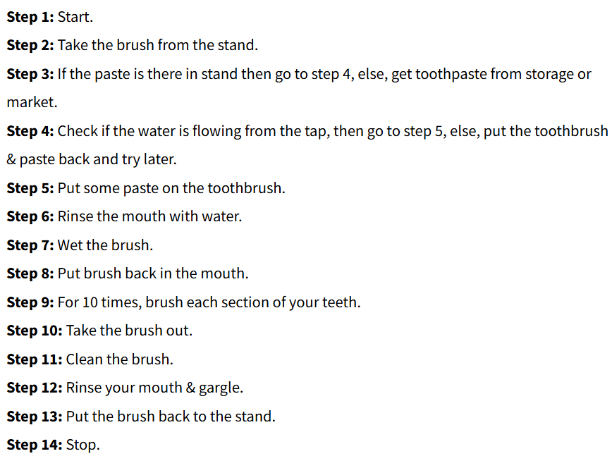
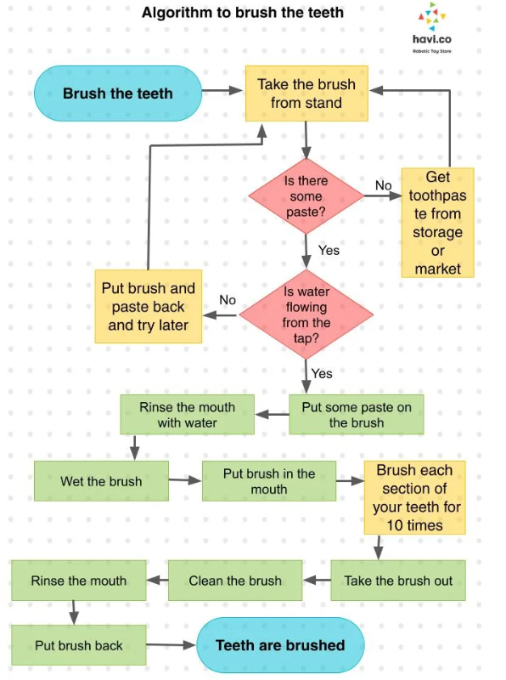
Algorithm Example in Everyday Life

Slide 37
Assignment2: write down at least 3 algorithms you interact with everyday.

Slide 38
Recursive Algorithm
In computer science, all algorithms are implemented with programming language functions.
We can view a function as something that is invoked (called) by another function.
It executes its code and then returns control to the calling function.
Here, a function can be called by itself or it may call another function which in turn call the same function inside it is known as recursion.
The function which is called by itself is known as Direct Recursive function.
The function which calls a function and that function calls its called function is known Indirect Recursive function.
A recursive algorithm is a powerful technique in data structures and algorithms where a function calls itself to solve a smaller instance of the same problem.
Example:
Factorial: f(n) = n*f(n-1), where f(0) = 1 for n>0.
Fibonacci numbers :f(n) = f(n-1) + f(n-2), where f(0) = 0, f(1) = 1.

Slide 39
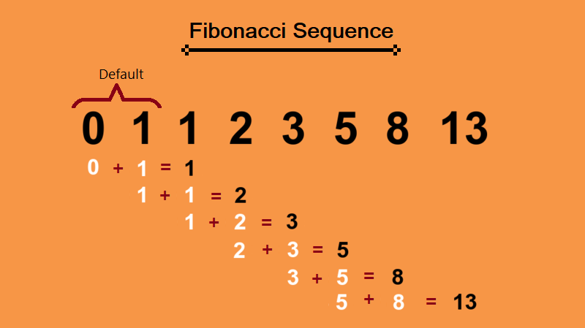
Recursive Algorithm
Factorial:
•Factorial (n)
•If n == 0 or 1 Return 1;
•Else Return n*Factorial(n-1);
Fibonacci:
•Fibonacci(n)
•if n <= 1 Return n;
•else Return Fibonacci(n-1) + Fibonacci(n-2);

Slide 40
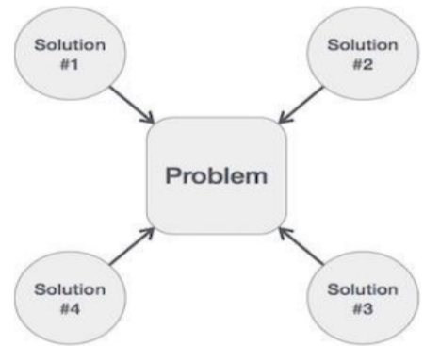
Performance Analysis
If we want to go from city "A" to city "B", there can be many ways of doing this. We can go by flight, by bus, by train and also by bicycle. Depending on the availability and convenience, we choose the one which suits us.
Similarly, in computer science, there are multiple algorithms to solve a problem. When we have more than one algorithm to solve a problem, we need to select the best one. Performance analysis helps us to select the best algorithm from multiple algorithms to solve a problem. When there are multiple alternative algorithms to solve a problem, we analyze them and pick the one which is best suitable for our requirements.
Performance of an algorithm is a process of making evaluative judgement about algorithms.
Performance of an algorithm means predicting the resources which are required to an algorithm to perform its task.

Slide 41
Performance Analysis
Generally, the performance of an algorithm depends on the following elements
Whether that algorithm is providing the exact solution for the problem?
Whether it is easy to understand?
Whether it is easy to implement?
How much space (memory) it requires to solve the problem?
How much time it takes to solve the problem? Etc.,
When we want to analyze an algorithm, we consider only the space and time required by that particular algorithm and we ignore all the remaining elements.
Based on this information, performance analysis of an algorithm can also be defined as follows:
Performance analysis of an algorithm is the process of calculating space and time required by that algorithm.
Performance analysis of an algorithm is performed by using the following measures
Space required to complete the task of that algorithm (Space Complexity).
Time required to complete the task of that algorithm (Time Complexity).

Slide 42
Space Complexity
When we design an algorithm to solve a problem, it needs some computer memory to complete its execution. For any algorithm, memory is required for the following purposes:
To store program instructions.
To store constant values.
To store variable values.
And for few other things like function calls, jumping statements, etc.
Total amount of computer memory required by an algorithm to complete its execution is called as space complexity of that algorithm.
Generally, when a program is under execution it uses the computer memory for THREE reasons:
Instruction Space: It is the amount of memory used to store compiled version of instructions.
Environmental Stack: It is the amount of memory used to store information of partially executed functions at the time of function call.
Data Space: It is the amount of memory used to store all the variables and constants.

Slide 43
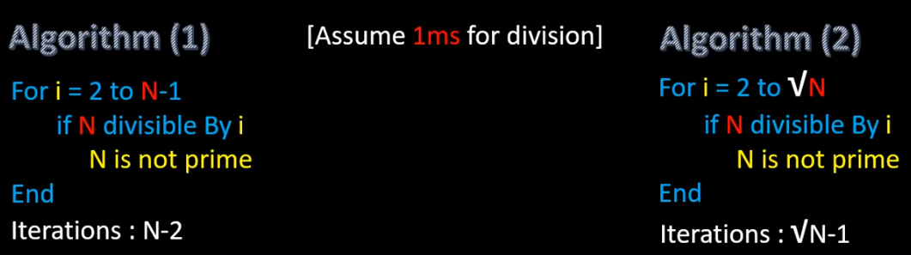
Performance Analysis – Time complexity

Slide 44
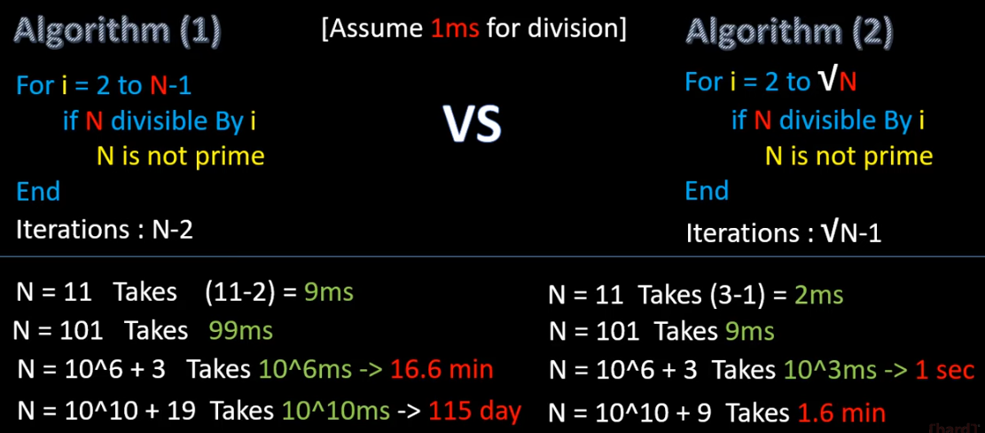
Performance Analysis – Time complexity

Slide 45
Time Complexity
The time complexity of a program is the amount of computer time it needs to run to completion.
The time complexity is of two types such as
Compilation time
Runtime
The amount of time taken by the compiler to compile an algorithm is known as compilation time. During compilation time it does not calculate for the executable statements, it calculates only the declaration statements and checks for any syntax and semantic errors.
The run time depends on the size of an algorithm. If the number of instructions in an algorithm is large, then the run time is also large, and if the number of instructions in an algorithm is small, then the time for executing the program is also small. The runtime is calculated for executable statements and not for declaration statements.

Slide 46

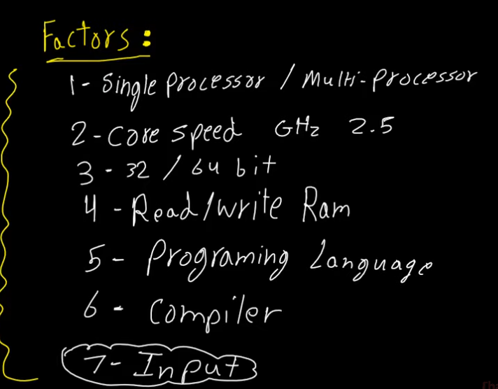

Time Complexity
Method1: Run the algorithm on a real machine
5 sec
10 sec
Algorithm

Slide 47
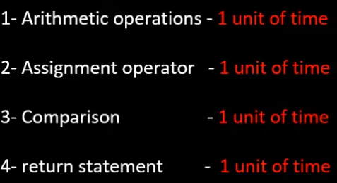
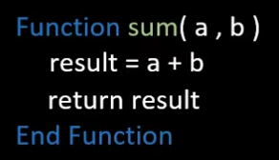
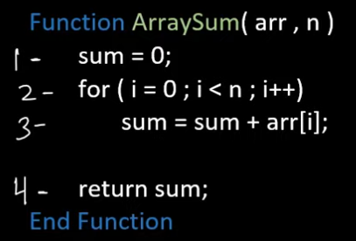
Time Complexity
Method2: Frequency Count Method
Time function f(n)=1+1+1=3
1
1
n
f(n)=(1+1+1)+(n+n+n)+n+1=4n+4
n+1

Slide 48
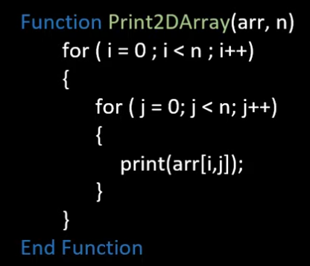
Time Complexity
1
n
n
f(n)=1+1+n+n=2n+2
1
n
n^2
f(n)=n+n^2+n^2=2n^2+n
n^2

Slide 49
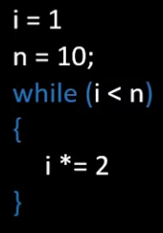
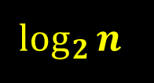
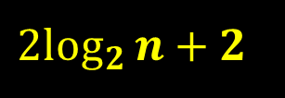

Time Complexity
1
1
$$\log_{2}{n}$$
$${2log}_{2}{n+2}$$
f(n)=
$$\log_{2}{n}$$

Slide 50
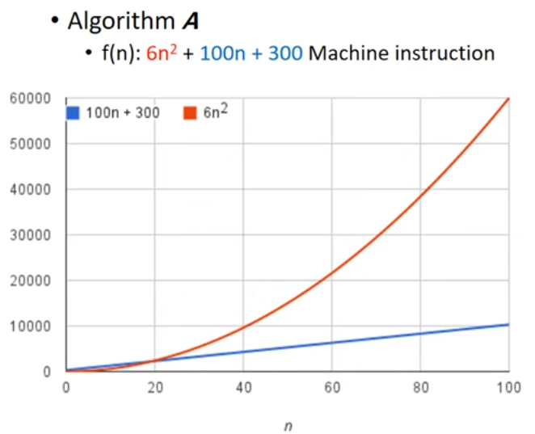
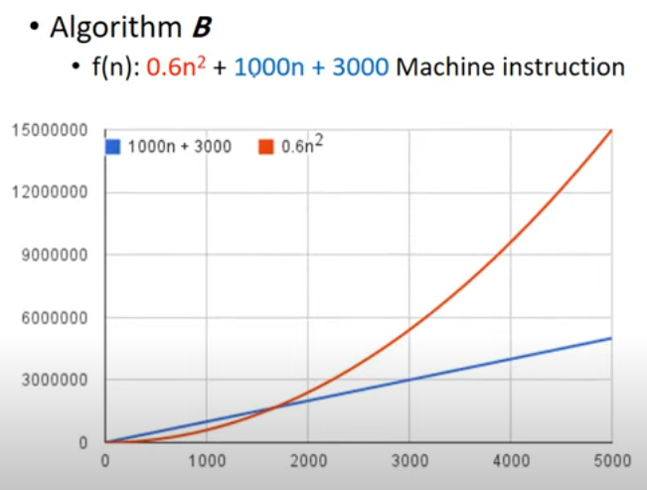

Slide 51
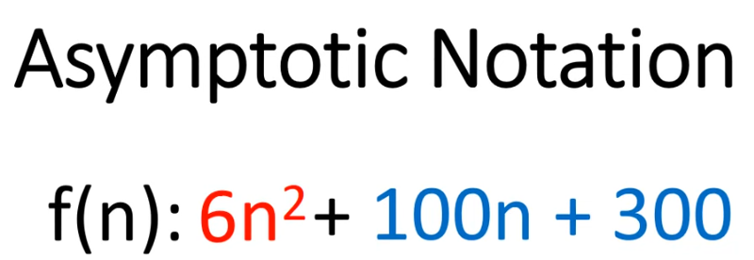
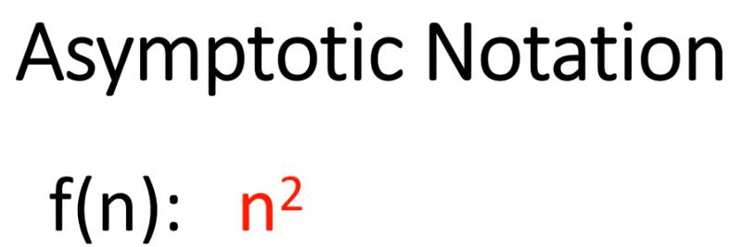

Slide 52
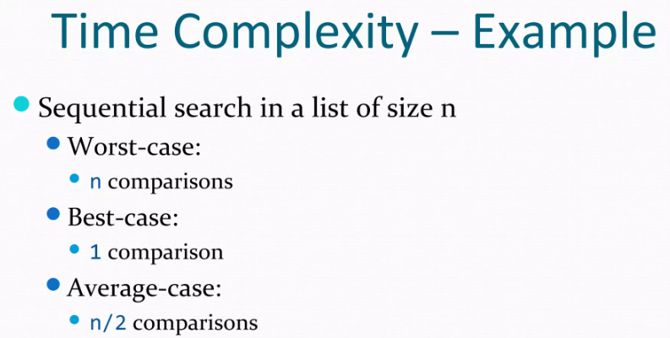
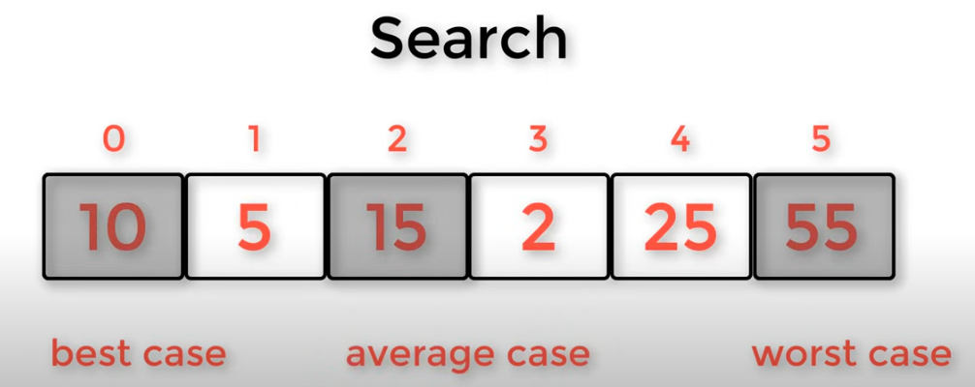
Time Complexity
Suppose space is fixed for one algorithm then only run time will be considered for obtaining the complexity of algorithm, these are
Best case
Worst case
Average case

Slide 53
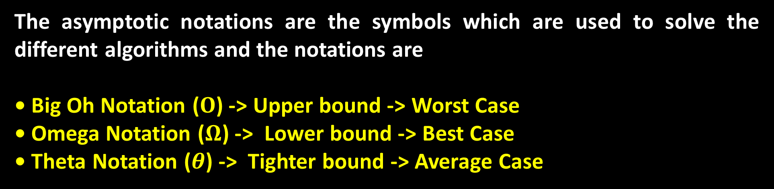
Asymptotic Notations
The asymptotic notations are the symbols which are used to solve the different algorithms and the notations are
• Big Oh Notation ($Ο$) -> Upper bound -> Worst Case
• Omega Notation ($Ω$) -> Lower bound -> Best Case
• Theta Notation ($θ$) -> Tighter bound -> Average Case

Slide 54
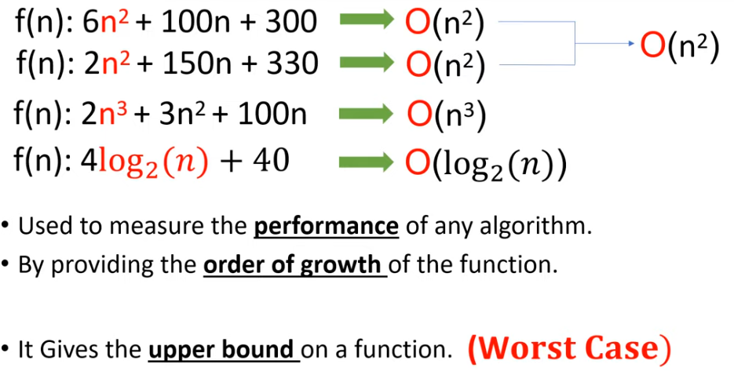
Big O Notation

Slide 55
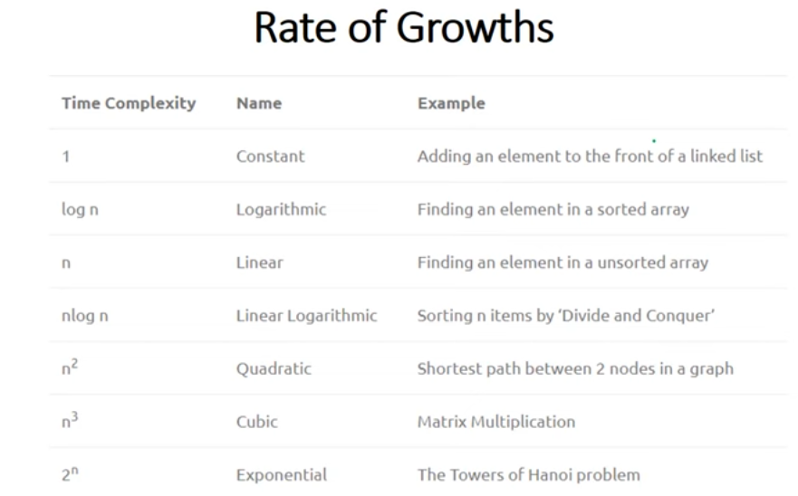



Slide 56

Big O Notation

Slide 57


Big O Notation

Slide 58



Big O Notation
$$f\left(n\right)=2n+6 \\ g\left(n\right)=n \\ let c=4 \\ 2n+6≤4n \\ 2n+6=4n⇒n_{0}=3$$

Slide 59






How to Determine Complexities
f(n)=1+1+1+….+1
$$Ο(1)$$
f(n)=time(seq1)+time(seq2)
$$Ο(max(time\left(seq1\right),time(seq2)))$$
f(n)=1+...+1+N
$$Ο(N)$$

Slide 60


How to Determine Complexities
f(n)=N*M
$$Ο(N∗M)$$

Slide 61




Examples
$$Ο(max(N,M))$$
$$Ο(N^{2})$$

Slide 62


Examples

Slide 63



Examples

Slide 64





O($n^{3}$)

Slide 65



2

Slide 66


Notes:
عدد الاستدعاءات ينمو بشكل أُسّي (Exponential).

Slide 67



Slide 68



Slide 69







Sheet2
Implement the Sparse Matrix using triplet representation method.
Implement some examples on classes.
What is the worst-case complexity of the each of the following code?

Slide 70







Solution of Section 3

Slide 71


